Slide 1
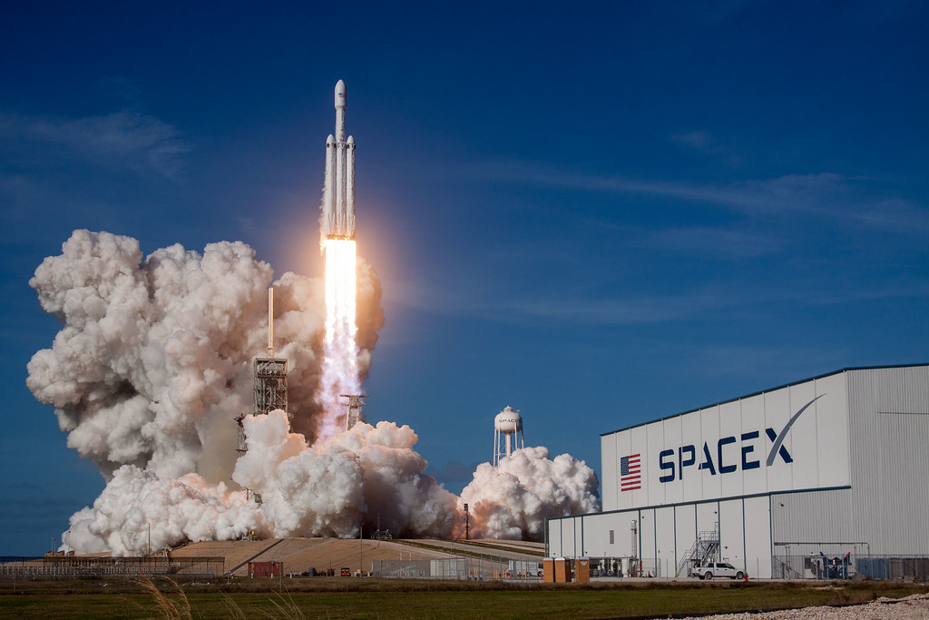

IBM-Data-Science-Capstone-SpaceX
Brent Williams
https://github.com/Brent-W/IBM
04/04/2022

Slide 2

Outline
Executive Summary
Introduction
Methodology
Results
Conclusion
Appendix

Slide 3
Executive Summary
Summary of methodologies
Data Collection via API
Data Collection via Web Scraping
Data Wrangling
Exploratory Data Analysis (EDA) with SQL
Exploratory Data Analysis (EDA) with Data Visualization
Interactive Visual Analytics with Folium and Plotly Dash
Machine Learning Prediction
Summary of all results
Exploratory Data Analysis (EDA) results
Interactive Analytics Images
Predictive Analytics Result

Slide 4
Introduction
Project background and context
SpaceX advertises the $ 62 million Falcon 9 rocket launch on its website. The other providers will cost more than $ 165 million, and much of the savings come from being able to reuse the first steps. Therefore, if you can determine if the first stage will land, you can determine the cost of the launch. This information can be used if an alternative company wants to bid on SpaceX for a rocket launch. The goal of this project is to build a machine learning pipeline and predict whether the first stage will land successfully.
Problems you want to find answers
What factors determine if the rocket will land successfully?
The interaction amongst various features that determine the success rate of a successful landing.
What operating conditions needs to be in place to ensure a successful landing program.

Slide 5

Section 1: Methodology

Slide 6
Methodology
Executive Summary
Data collection methodology:
Data was collected using SpaceX API and web scraping.
Performed data wrangling
One-hot encoding method was applied to the categorical features in the data.
Classifying landings as successful or unsuccessful.
Performed exploratory data analysis (EDA) using visualization and SQL
Performed interactive visual analytics using Folium and Plotly Dash
Performed predictive analysis using classification models
Models were tuned using GridSearchCV.

Slide 7
Data Collection
The data was collected using various methods:
Data collection was through the SpaceX API using the get request method.
We decoded the response content as a Json using .json() function call and converted it into a Pandas data frame using the .json_normalize().
Then we cleaned the data thoroughly by checking for missing values and filled in missing values where it was necessary.
We also performed web scraping from Wikipedia for Falcon 9 launch records by using the BeautifulSoup package.
The objective was to extract the launch records as HTML table, parse the table and convert it to a pandas dataframe for future analysis.

Slide 8
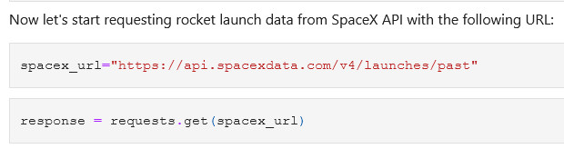
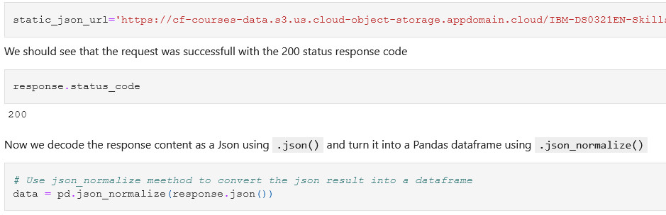
Data Collection – SpaceX API
We used the get request to the SpaceX API to collect data, clean the requested data and did some basic data wrangling and formatting.
The link to the notebook is https://github.com/Brent-W/IBM/blob/master/Week%201%20:%20SpaceX%20Falcon%20Data%20Collection-Wrangling.ipynb

Slide 9
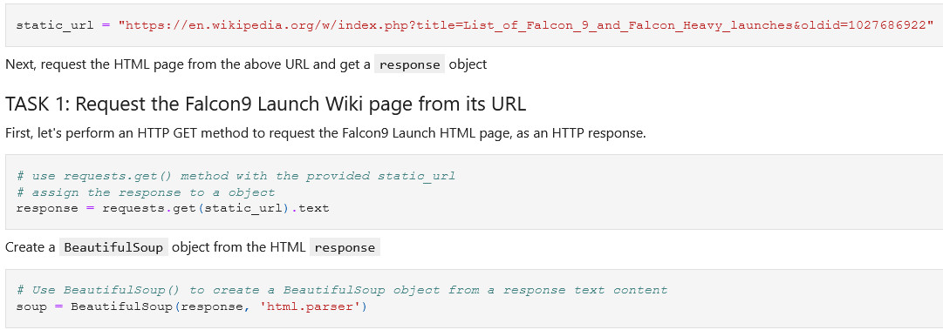
Data Collection - Scraping
We used web scrapping with BeautifulSoup to collect Falcon 9 launch records from Wikipedia.
We used the html parser and converted it into a Pandas data frame.
The link to the notebook is https://github.com/Brent-W/IBM/blob/master/Week%201:%20Data%20Collection%20with%20Web%20Scraping.ipynb

Slide 10
Data Wrangling
Through this process we used exploratory data analysis (EDA) and determined exactly what labels were the training labels.
During this process we also calculated the amount of launches that occurred at each site, and the number and occurrence of each orbits.
We also created a landing outcome label from the outcome column and exported the final results to a csv file.
The link to the notebook is https://github.com/Brent-W/IBM/blob/master/Week%201:%20EDA%20(Data%20Wrangling).ipynb

Slide 11
EDA with Data Visualization
Here we explored the relationship between:
Flight number and Launch Site
Payload and Launch site
Success rate of each orbit type
Flight number and Orbit Type
And finally, the launch success yearly trend
The link to the notebook is https://github.com/Brent-W/IBM/blob/master/Week%202:%20EDA%20with%20Data%20Visualization.ipynb

Slide 12
EDA with SQL
We loaded the SpaceX dataset into IBM Db2 database and connected to it using Jupyter Notebooks.
We applied EDA with SQL to get insights from the data. We wrote queries to find out for instance:
The unique launch sites in the space mission.
The total amount of payload mass that was carried by boosters launched by NASA (CRS)
The average payload mass carried by booster version F9 v1.1
The total amount of mission outcomes that were successful or a failure
The landing outcomes in drone ship, their booster version and launch site names that failed.
The link to the notebook is https://github.com/Brent-W/IBM/blob/master/Week%202:%20EDA%20with%20SQL.ipynb

Slide 13
Build an Interactive Map with Folium
Using Folium, we marked all the launch sites, and added objects like markers, circles, lines to mark and show the success or failure of launches for each site on the Folium map.
We assigned the launch outcomes to 0 and 1. 0 for failure and 1 for successful.
We identified which launch sites have relatively high success rate by using color-labeled marker clusters.
We used Folium to calculate the distances between a launch site to certain places. For example:
How near are the launch sites torailways, highways and coastlines?
What is the approximate distance that the launch sites are from cities?
Link to the notebook is https://github.com/Brent-W/IBM/blob/master/Week%203:%20Interactive%20Visual%20Analytics%20with%20Folium.ipynb

Slide 14
Build a Dashboard with Plotly Dash
Using Plotly Dash, we built an interactive dashboard of the data.
We used pie charts to show the total launches that occurred in each site.
We also plotted a scatter graph that visualized the relationship between the Outcome and Payload Mass (Kg) for all the different booster versions.
The link to the notebook is https://github.com/Brent-W/IBM/blob/master/Week%203:%20Build%20an%20Interactive%20Dashboard%20with%20Ploty%20Dash.py

Slide 15
Predictive Analysis (Classification)
In this phase we used Pandas and NumPy to transform the data, and we also used Scikit-Learn to split the data into training and test sets.
We used different machine learning classification models and tuned different hyperparameters using the GridSearchCV.
Using accuracy as an indicator of the model, we improved the model through feature engineering and algorithm tuning.
We also determined which classification model performed the best.
The link to the notebook is https://github.com/Brent-W/IBM/blob/master/Week%204:%20Machine%20Learning%20Prediction.ipynb

Slide 16
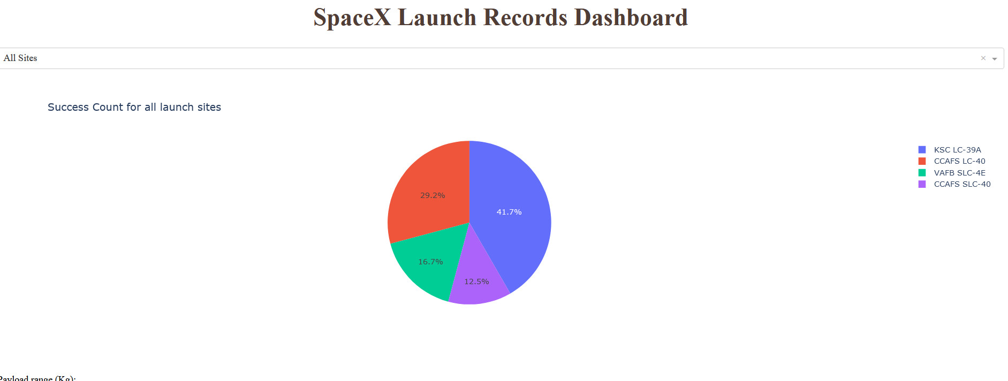
Results
This image is a preview of the Plotly dashboard and the following slides will show the results of the exploratory data analysis (EDA) with the visualizations, SQL, the interactive map with Folium and the result of our classification model.

Slide 17

Section 2: Insights drawn from
Exploratory Data Analysis (EDA)

Slide 18
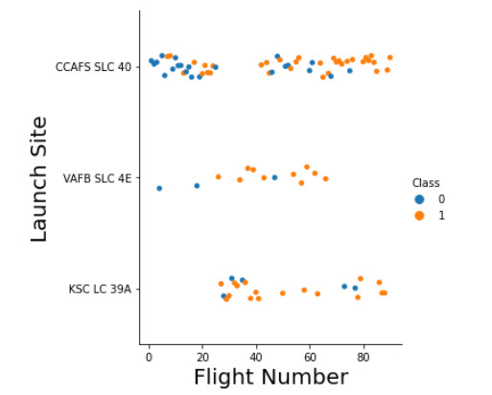
Flight Number vs. Launch Site
From the scatter plot we find that the higher the number of flights at the launch site, the higher the success rate at the launch site.
CCAFS appears to be the main launch site as it shows the most number of launches.
In the graph, blue indicates an unsuccessful launch and orange indicates a successful launch.

Slide 19
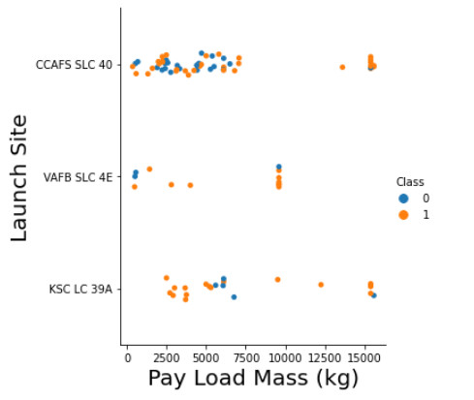
Payload vs. Launch Site
When looking at the mass of the payload mass, it mostly seems to fall between 0-6000 Kg.
It also seems to appear that different launch sites vary in the mass that they use.
0 indicates an unsuccessful launch and 1 indicates a successful launch.

Slide 20
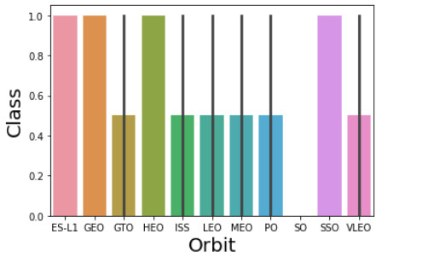
Success Rate vs. Orbit type
In the graph, the scale is as follows:
0 indicates a 0% success rate.
0.4 indicates a 40% success rate
1 indicates a 100% success rate
ES-L1, GEO, HEO, and SSO has a 100% success rate
GTO, ISS, LEO, MEO, PO, and VLEO all have a success rate of approximately 50%

Slide 21
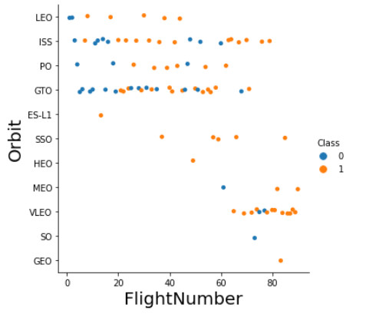
Flight Number vs. Orbit Type
The scatter plot shows the Flight Number vs. Orbit type.
According to the plot, Launch Orbit preferences changed over Flight Number.
We note that SpaceX appears to perform better in lower orbits.

Slide 22
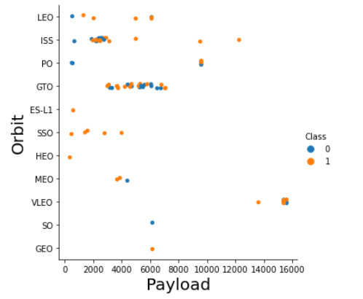
Payload vs. Orbit Type
From the scatter plot, we can see that there’s a strong correlation between the payload and the orbit.
We see that the orbit VLEO only has a payload mass in the higher end of the range.
0 indicates an unsuccessful launch, and 1 indicates a successful launch.

Slide 23
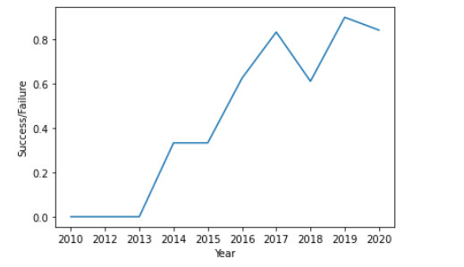
Launch Success Yearly Trend
Based on the graph we can see success generally increases over time since 2013 with a slight dip in 2018
We can see that the success in recent years at around 80%
By 2019 we see another increase that goes slightly above 80%

Slide 24
EDA with SQL
Exploratory data analysis (EDA) with SQL using IBM Db2 and Jupyter Notebook
24

Slide 25
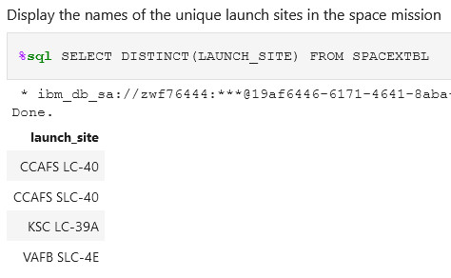
Distinct Launch Site Names
Using SQL, we used the keyword DISTINCT to search the table for distinct launch site names.
When looking at CCAFS LC-40 and CCAFS SLC-40 could be the exact same launch site, but someone made a data entry error that caused the names to differ.

Slide 26
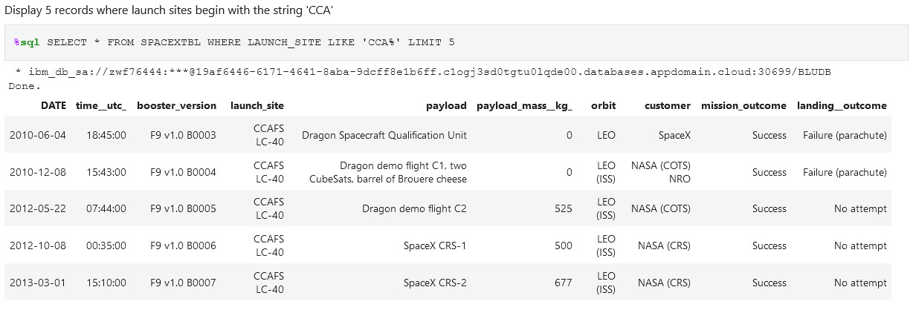
Launch Site Names Begin with 'CCA'
We used this query to collect 5 records where the launch site name began with ‘CCA’

Slide 27
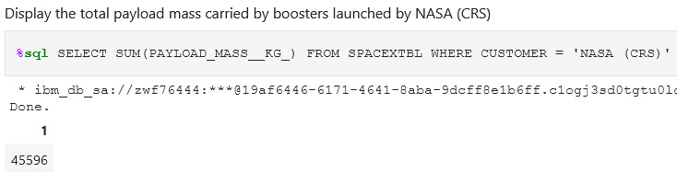
Total Payload Mass by NASA (CRS)
This query sums the total payload mass in kg where NASA was the customer, and the total amounted to 45596 kg.
CRS stands for Commercial Resupply Services which shows that those payloads had been despatched to the International Space Station (ISS).

Slide 28
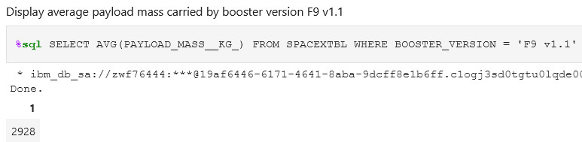
Average Payload Mass by F9 v1.1
Using this query we calculated the average payload mass that was carried by booster version F9 v1.1.
We see that the average falls on the low end range of the payload mass.

Slide 29
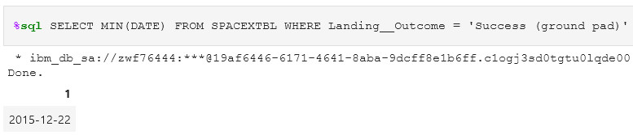
First Successful Ground Landing Date
Using this query, we extracted the date of the first successful landing outcome on ground pad which occurred on the 22nd December 2015.

Slide 30
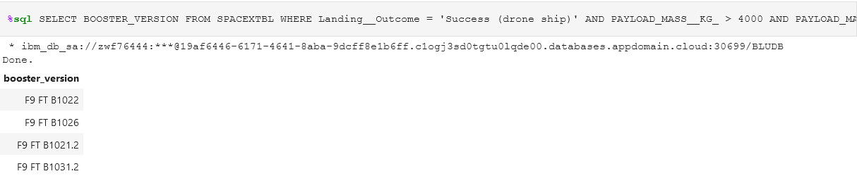
Successful Drone Ship Landing with Payload between 4000 and 6000
In this query, we used the WHERE clause to filter for boosters which have successfully landed on drone ship and applied the AND condition to determine successful landing with payload mass greater than 4000 but less than 6000

Slide 31
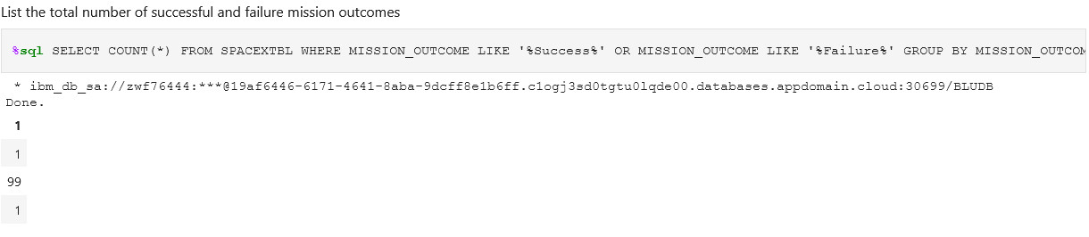
Total Number of Successful and Failure Mission Outcomes
We used the symbol like ‘%’ to filter in the WHERE clause whether the Mission Outcome was a success or a failure.
There was 1 failure (in flight)
99 successful mission outcomes.
1 success but the payload status is unclear.

Slide 32
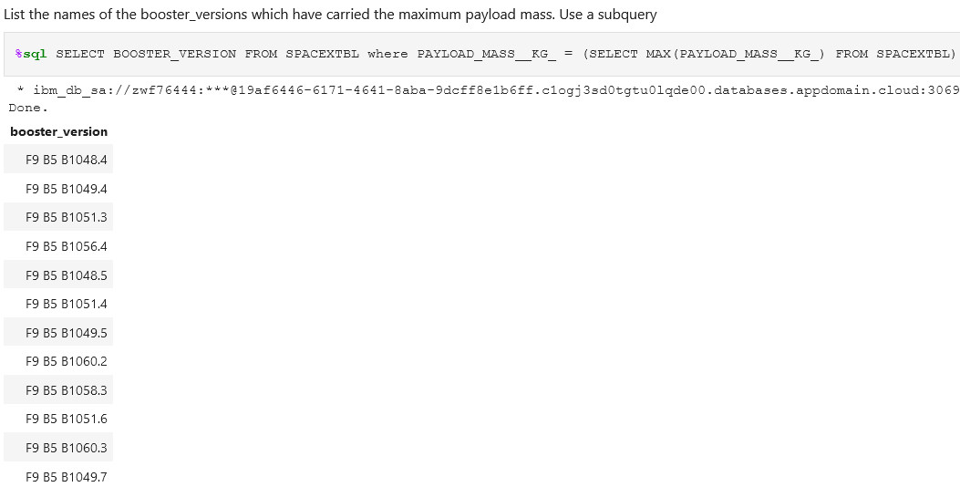
Boosters that Carried Maximum Payload
This query returns the booster versions that carried the highest payload mass which amounted to 15600 kg.
We can see that all booster versions are almost alike and all are of the F9 B5 B10xx.x category.

Slide 33
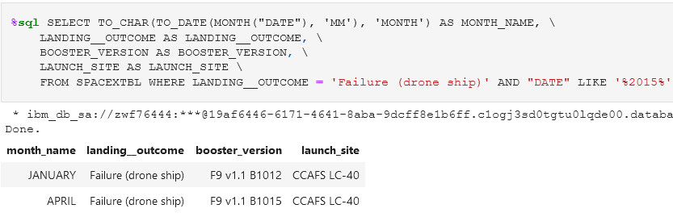
2015 Launch Records That Failed
We used a combinations of the WHERE, LIKE, and AND clause to filter for failed landing outcomes in drone ships, their booster versions, and launch site names that occurred in the year 2015.
We find that there were 2 occurrences in January and April.

Slide 34
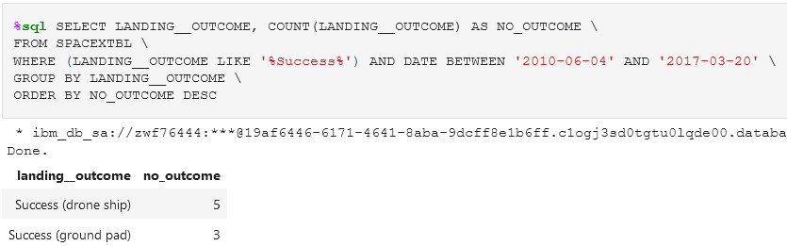
Rank Landing Outcomes Between 2010-06-04 and 2017-03-20
We selected Landing outcomes and the COUNT of landing outcomes from the dataset and used the LIKE and WHERE clause to filter for successful landing outcomes BETWEEN 2010-06-04 AND 2017-03-20.
We used the GROUP BY clause to group by the different successful landing outcomes and the ORDER BY clause to order the grouped landing outcome in descending order.

Slide 35
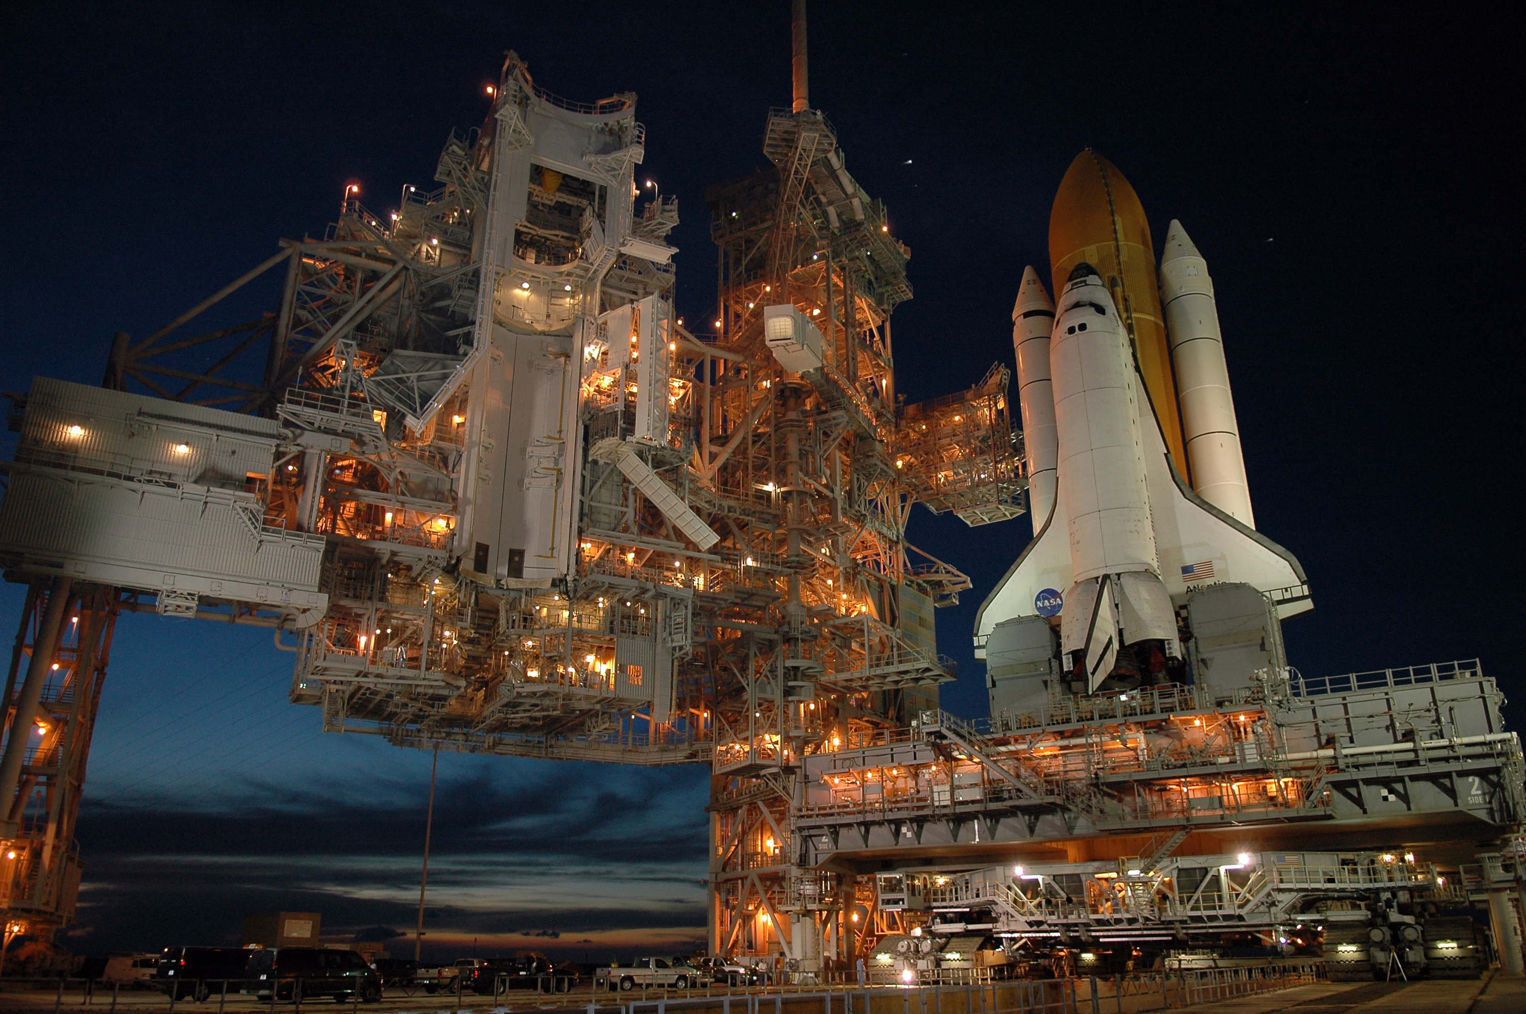
Section 3: Launch Sites Proximities Analysis

Slide 36
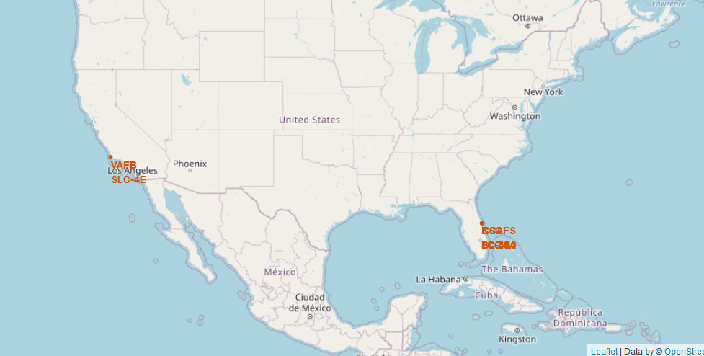
Launch Site Locations
This map shows all the launch sites on the US map.

Slide 37
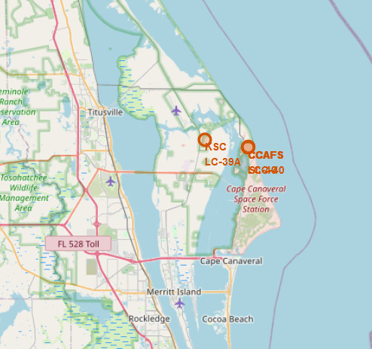
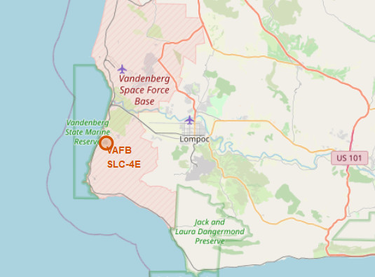
Launch Site Locations – Continued
The map on the left side shows the launch sites that are located in Florida.
The map on the right side shows the launch site that are located in California.

Slide 38
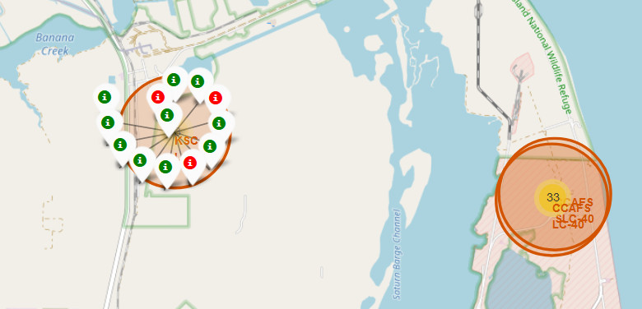
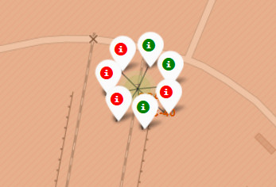
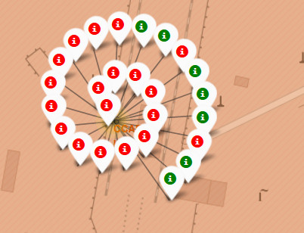
Markers showing launch sites with color labels – Florida
On the marker shown Green indicates a successful landing, while a red marker shows a failed landing.

Slide 39
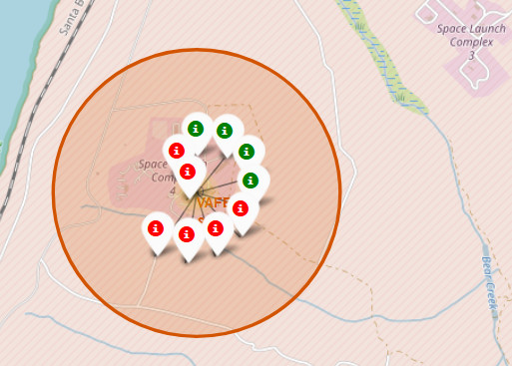
Markers showing launch sites with color labels – California
This map shows the markers of the launch site in California.
The green markers indicates a successful landing while a red marker indicates a failed landing.
By this launch site, we see that there were 4 landings that were successful while there were 6 failed landings.
39

Slide 40
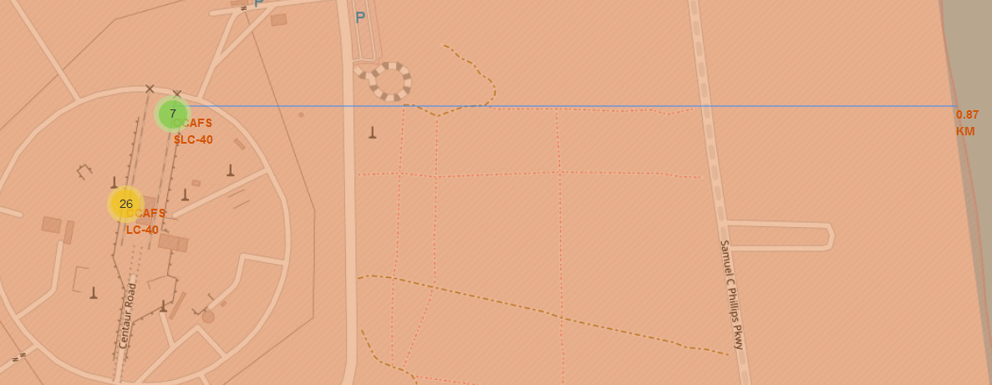
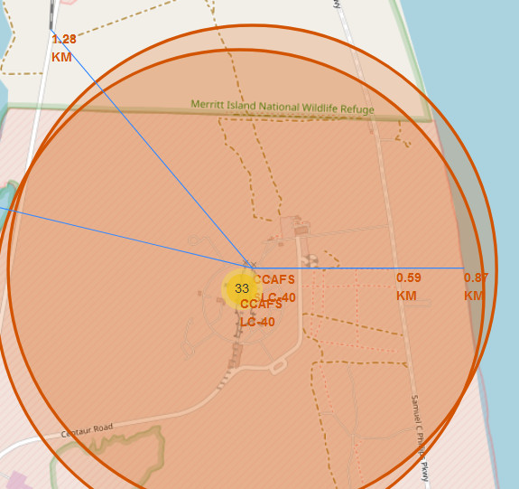
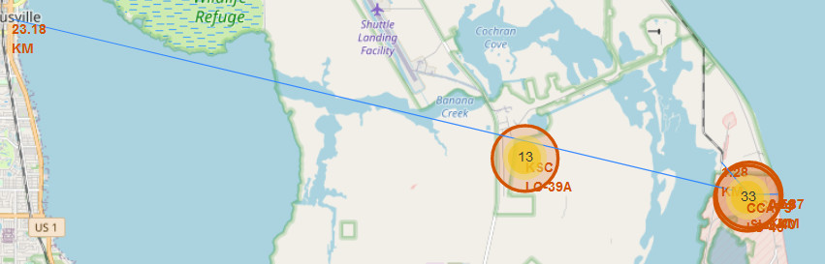
Florida Launch Site Distance to Different Landmarks
We can see that the launch site is very close to the railway for supply transportation
The launch site is also close to the coast but keeps a distance from cities for safety reasons.

Slide 41

Section 4: Insights from Dashboard created by Plotly Dash

Slide 42
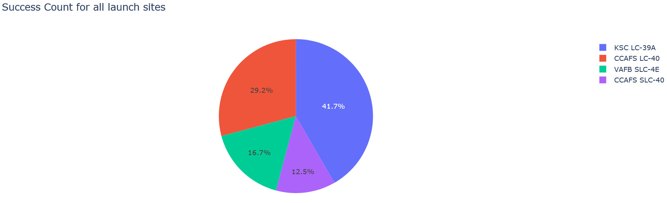
Success Percentage achieved by each launch site using a Pie Chart
We can see that the launch site KSC LC-39A had the most success rate with 41.7%

Slide 43
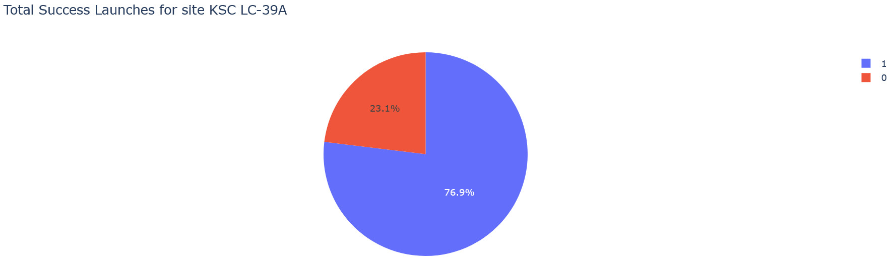
Launch site with the Highest Launch Success Ratio
The launches for site KSC LC-39A had 10 successful launches and 3 failed launches.

Slide 44
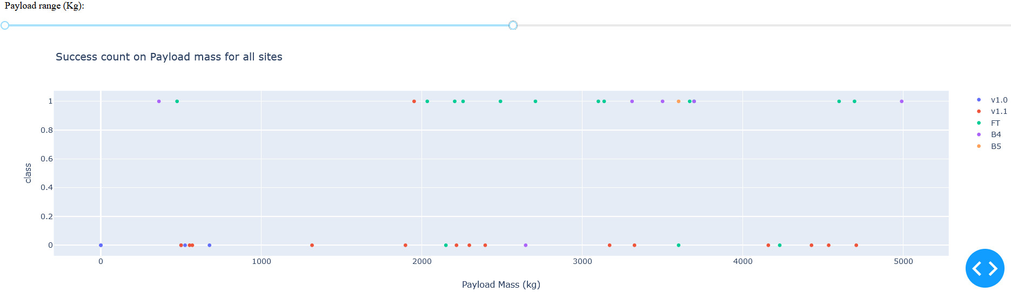
Scatter plot of Payload vs Launch Outcome for all sites, with different payload selected in the range slider
This scatter plot shows the launch outcomes for every site with a payload mass starting at 0 kg and going all the way up to 5000 kg.
We see that a booster version v1.0 failed with a payload mass of 0.

Slide 45
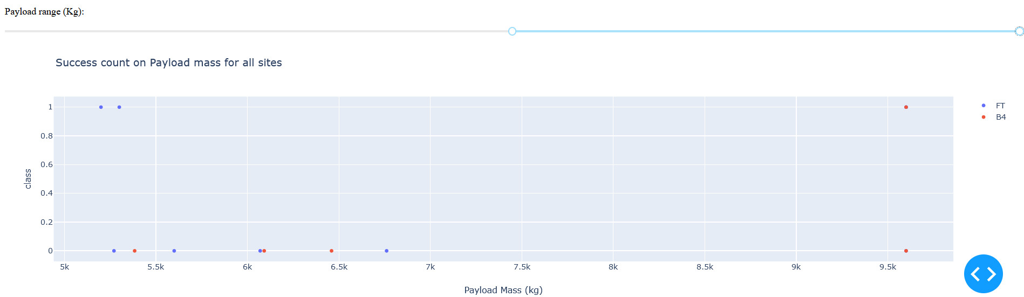
Scatter plot of Payload vs Launch Outcome for all sites, with different payload selected in the range slider - Continued
We see that as the payload mass increases from a range of 5000 kg to 10000 kg,
There are more failed launches than successful launches.
45

Slide 46

Section 5: Predictive Analytics (Classification)

Slide 47
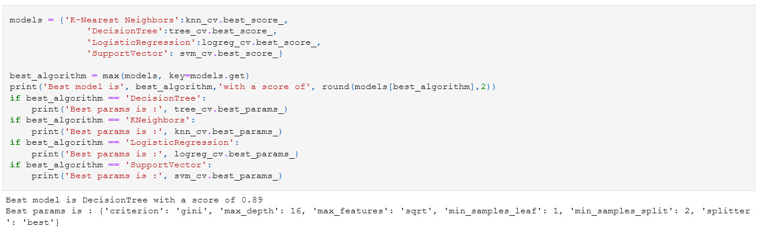
Classification Prediction Accuracy
Using Scikit-Learn and GridSearchCV, we found that the Decision Tree Classifier performed the best with a score of 89%

Slide 48
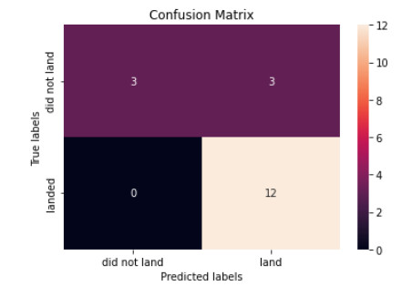
Confusion Matrix – Decision Tree Classifier
The confusion matrix for the decision tree classifier demonstrates the classifier’s ability to distinguish between the different classes.
However, there are problems like the false positives. These are unsuccessful landings that were marked as being a successful landing by the classifier itself.

Slide 49
Conclusion
We can conclude that:
The larger the number of lights that occur at a launch site, the greater the success rate will be of the launch site.
Based on the analysis done on the data we see that the success rate of launches increased from 2013 to 2020.
Orbits ES-L1, GEO, HEO, and SSO had the highest success rates.
Based on the Plotly dashboard, we see that the site KSC LC-39A had the highest launch success ratio than any other site.
Using Machine Learning on the data, we determined that the Decision Tree Classifier was the best method to make predictions.

Slide 50
Appendix
GitHub Repository URL:
https://github.com/Brent-W/IBM
Instructors:
Rav Ahuja, Alex Aklson, Aije Egwaikhide, Svetlana Levitan, Romeo Kienzler, Polong Lin, Joseph Santarcangelo, Azim Hirjani, Hima Vasudevan, Saishruthi Swaminathan, Saeed Aghabozorgi, Yan Luo
Special thanks to all the instructors of this course:
https://www.coursera.org/professional-certificates/ibm-data-science?&instructors#instructors
50

Slide 51
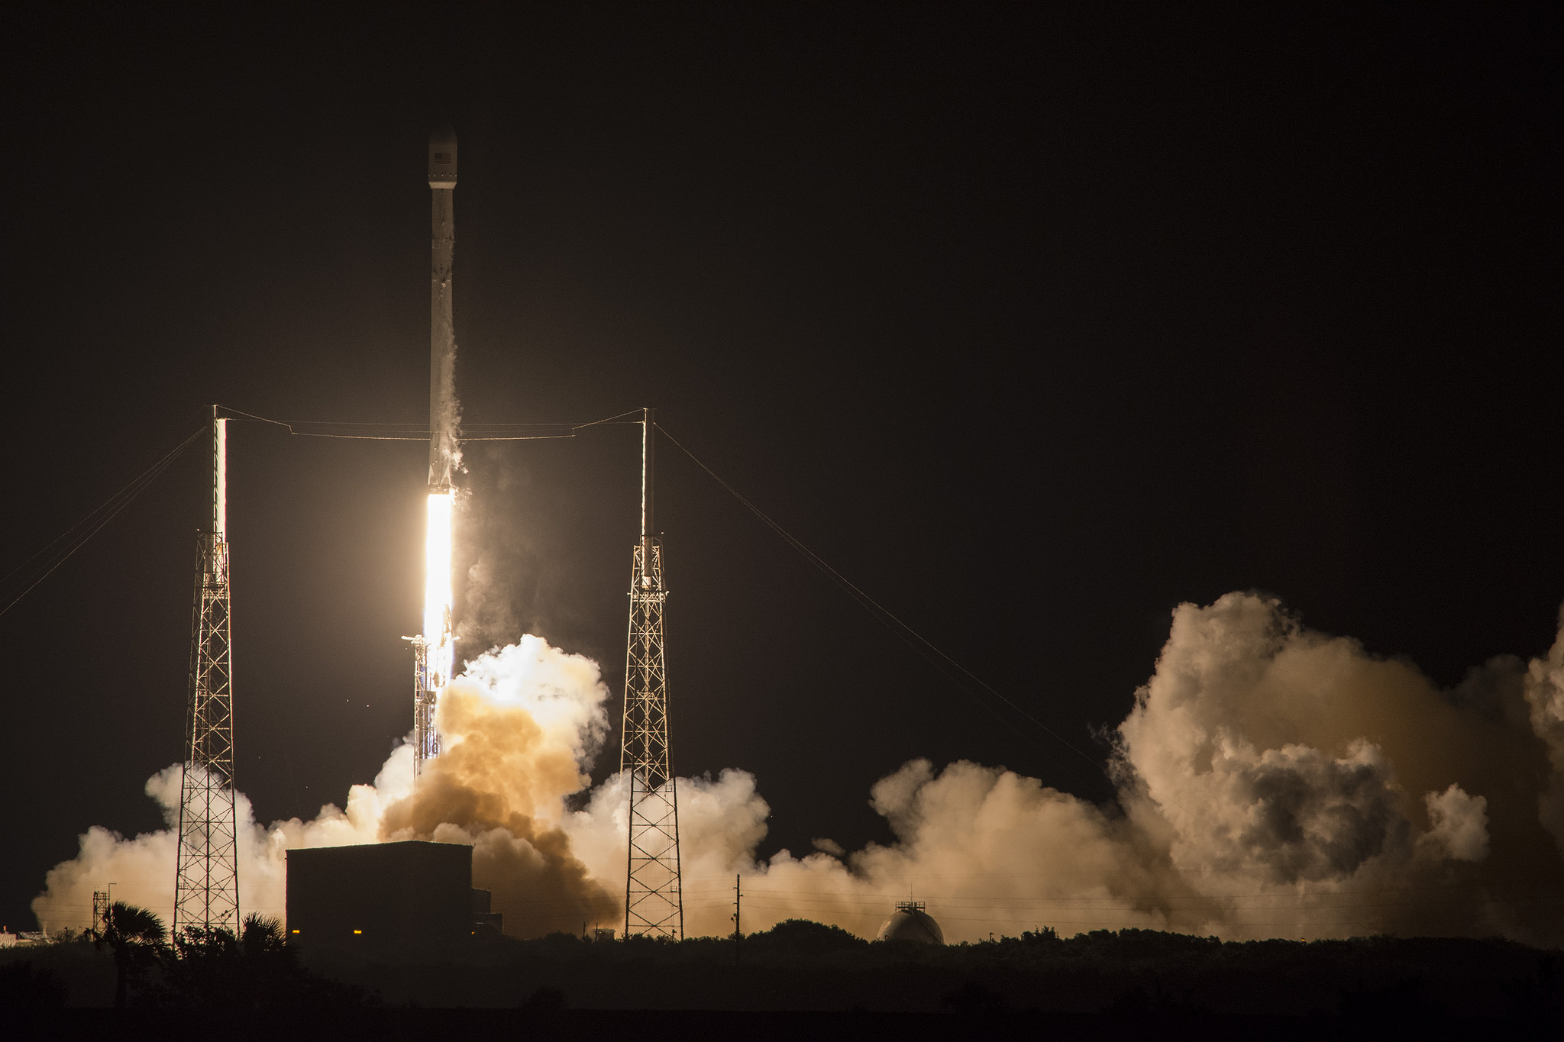
Thank You!

